Slide 1
Welcome to our class

Slide 2
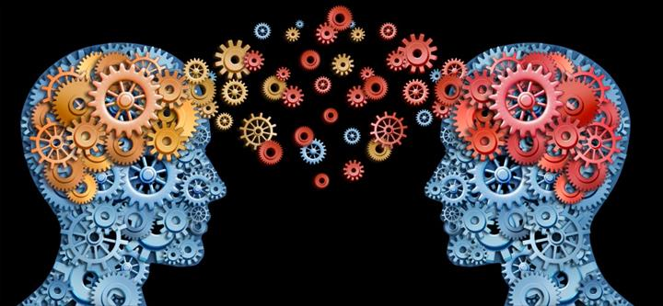
Game: Hidden doors
- There are four pictures of four people who are famous lifelong learners.
- The pictures will be opened slowly.
- Guess the people in the picture.

Slide 3
Bill Gates

Slide 4
President Ho Chi Minh

Slide 5
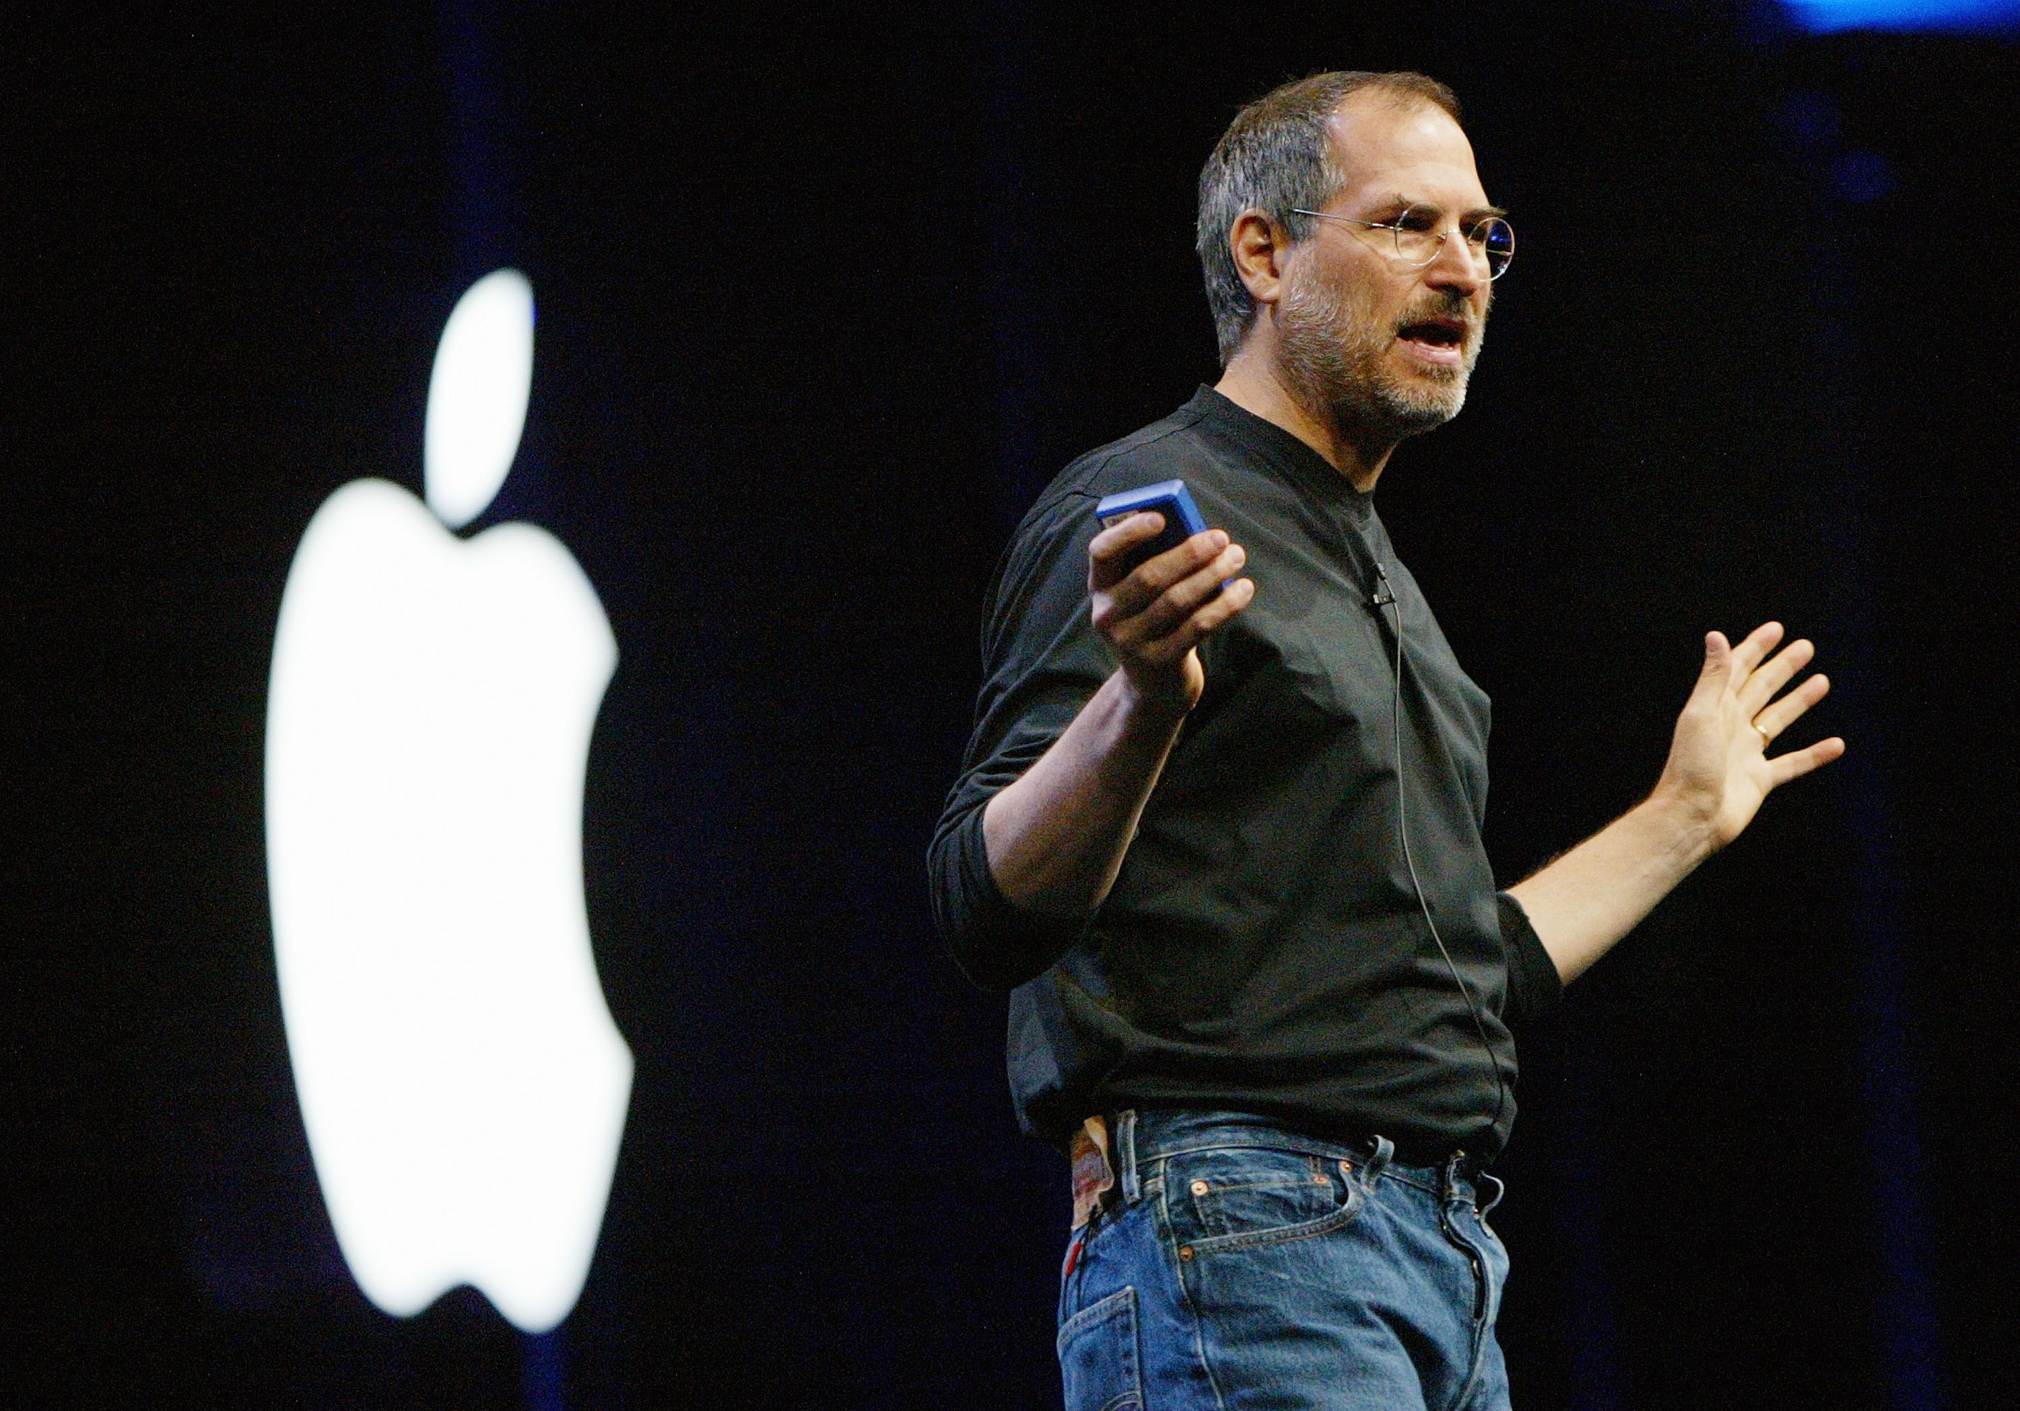
Steve Jobs

Slide 6
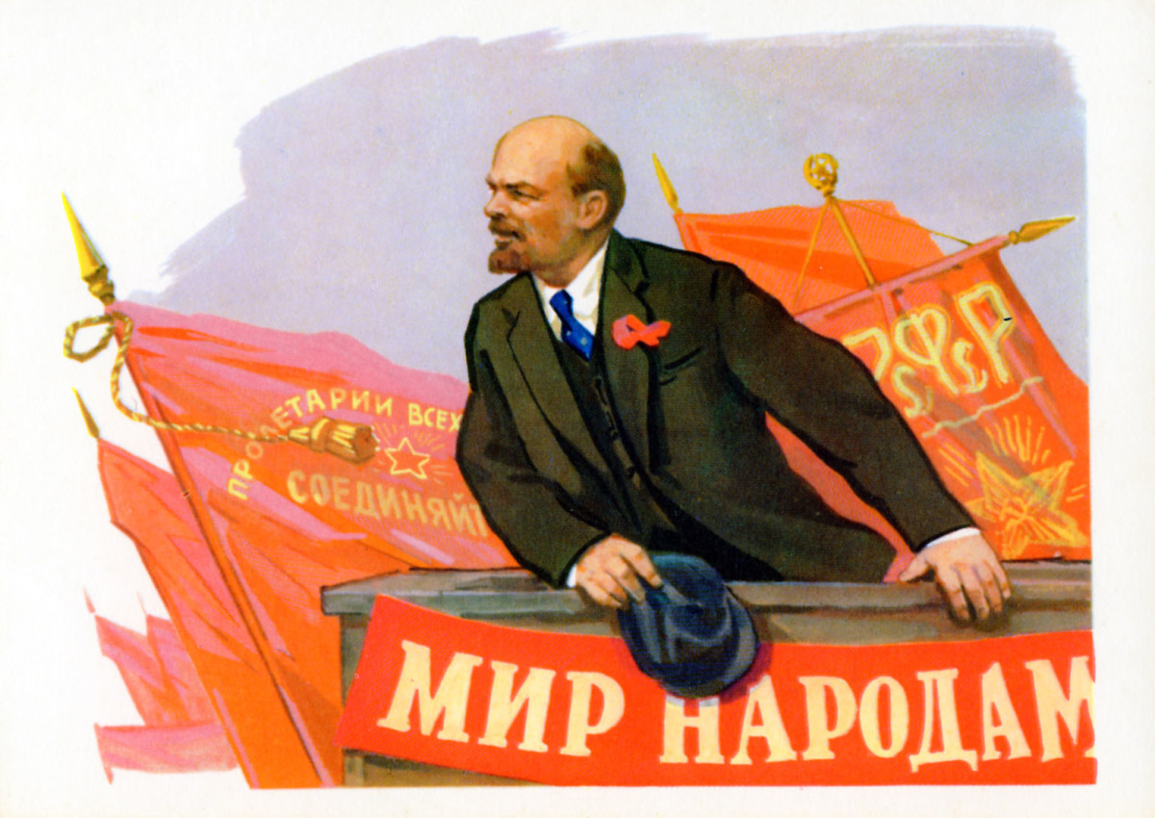
Lenin

Slide 7
Why did these people succeed in life?

Slide 8
UNIT 10: LIFELONG LEARNING
Lesson 5: Listening
A successful lifelong learner

Slide 9
Vocabulary

Slide 10
Achiever (n)
/ə't∫i:vər/

Slide 11
Mining (n)
/'mainiη/

Slide 12
Kick-start (v)
/'kikstɑ:t/

Slide 13
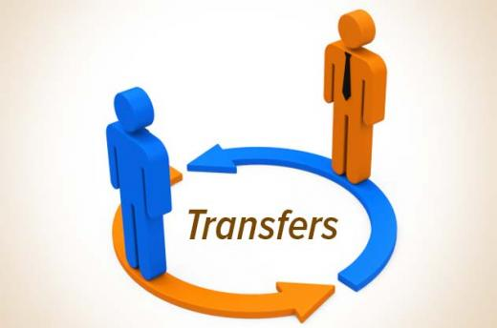
Transfer
/træn'sfɜ:[r]/

Slide 14
Bilingual (adj)
/,bai'liŋgwəl/
Xin chào
Hello

Slide 15
Vocabulary
- Achiever (n) :
/ə't∫i:vər/
- Mining (n):
/'mainiη/
- Kick-start (v):
/'kikstɑ:t/
- Transfer (v):
/træn'sfɜ:[r]/
- Bilingual (adj):
/,bai'liŋgwəl/

Slide 16
Task 1. Work in pairs. Match the words (1-5) with their meanings (a-e).
Words | Meanings
1. Achiever | a. The industry which exploits goal and other minerals from under the ground.
2. Mining | b. A special right or an advantage for someone.
3. Kick-start | c. Move someone from one place to another
4. Privilege | d. A person who highly succeeds in career
5. Transfer | e. Begin a career or project quickly.

Slide 17
Task 2. Listen to a talk show about lifelong learning and choose the best answers.
1. What was Juliet’s part –time job?
A. An artist C. A project manager
B. A teaching assistant D. A marketing manager
2. What did Julie study while having a part-time job?
A. A project management course C. A Vietnamese language course
B. A marketing course D. An international business course
3. What type of company is West Corner?
A. Hospitality B. training C. Mining D. Marketing
4. What did Julie study in order to develop her professional skills?
A. Vietnamese language and culture C. Marketing
B. Project development and management D. Design
5. Why was Julia promoted?
A. Because she had the right qualifications and spoke both English and Vietnamese.
B. Because she kept studying to improve her design skills.
C. Because she was Vietnamese.
D. Because she was good at project management.
B
D
C
B
A

Slide 18
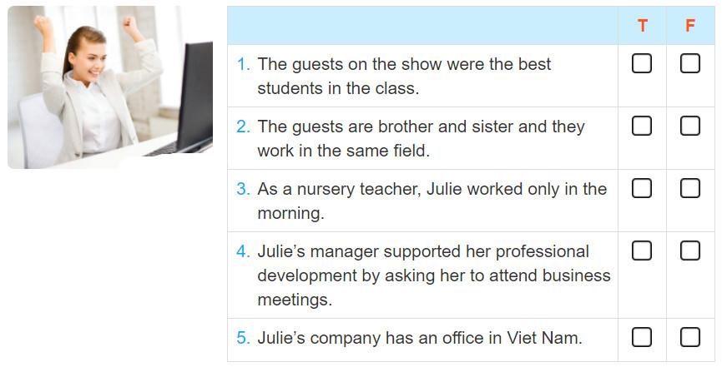
Task 3. Listen again and decide if the statements are true (T) or false (F). Tick the correct box.
V
V
V
V
V

Slide 19
Task 4. Work in pairs. Ask and answer questions about someone you know that has succeeded in life thanks to lifelong learning.
A. Do you know C?
B. Yes, I know.
A. What's was C's job?
B. He/She was a……………………………….
A. What did C study while working?
B. She/He………………………………………..
A. Why was C promoted?
B. Beacause…………………………………….

Slide 20
Homework
Learn all the new vocabulary by heart
- Prepare the next lesson: Writing

Slide 21
Thank you

